Slide 1
NAME- SAKSHI MITTAL B.TECH COMPUTER SCIENCE
SECTION- C STUDENT ID- 21012073
ROLL NO- 51 UNIVERSITY ROLL NO- 2119095

Slide 2
MINI PROJECT ON
Guess The
Word

Slide 3
INDEX
CHAPTER 1
CHAPTER 2
CHAPTER 3
CHAPTER 4
CHAPTER 5
CHAPTER 6
CHAPTER 7
Introduction
Why this?
Methodology
How to play?
Updates
Result and Outcomes
Reference

Slide 4
INTRODUCTION
Hangman is a guessing game for two or more players. One player thinks of a word, phrases or sentence and the other tries to guess it by suggesting letters within a certain number of guesses. Originally, this is a Paper-and-Pencil-game.
But now,
LETS moves with “ADVANCE TECHNOLOGY”

Slide 5
WHY THIS?
helps in improving vocabulary
helps in improving spelling
encourages quick thinking
increases a child’s interest in reading and writing
helps in enhance memory

Slide 6
METHODOLGY
HTML- used for the structure of the pages like in text, button and linking one page to another.
CSS- used for the designing in the page like changing colours of text, changes in the background, designing button etc
JAVA SCRIPT- This is the main section of this web d. This is used for the logical designing of this game like which word have to be selected, when it will show you win or you lost, and how game will restart.

Slide 7
HOW TO PLAY?
In this, We have to guess a game
No of blank dashes are present on the screen which is equal to the length of the word.
Individual have to enter the enter
If the entered letter is present in the word then it will display on the screen else part of a man is drawn
If a word is complete before the man tie then the individual Win the game else if the man is completed hang then You lost the game.

Slide 8
UPDATES
Previous
New
No of dashes are present to represent the length of word.
When the user will guess the letter it will display on the respective position.
After the letter display on the position, number of dashes are still there to give idea how much letters will come in between.
Figure will update when user presses any wrong key.
Length of word is given instead of the blank spaces.
When the user will guess the letter, it only display on the screen before or after the letter present there.
After the letter display on the position, there are no which give an idea of how much letters will come in between.
Figure will update when user presses wrong letter not on number or any functional key.

Slide 9
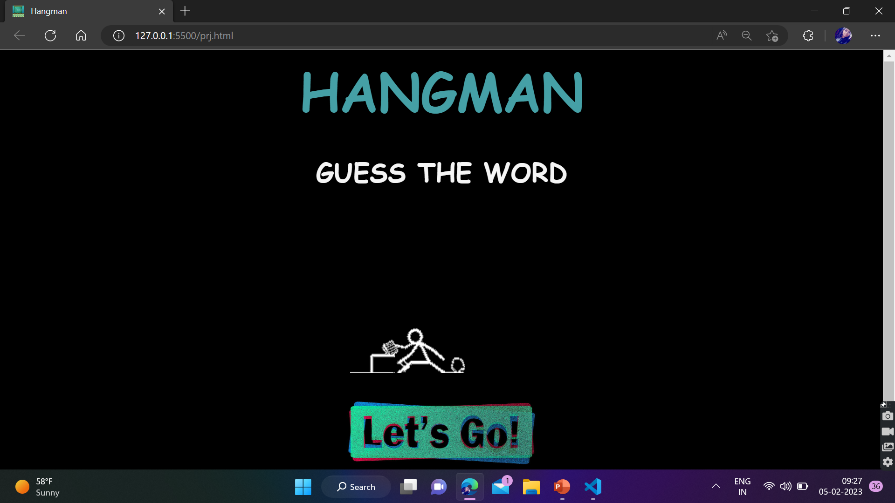
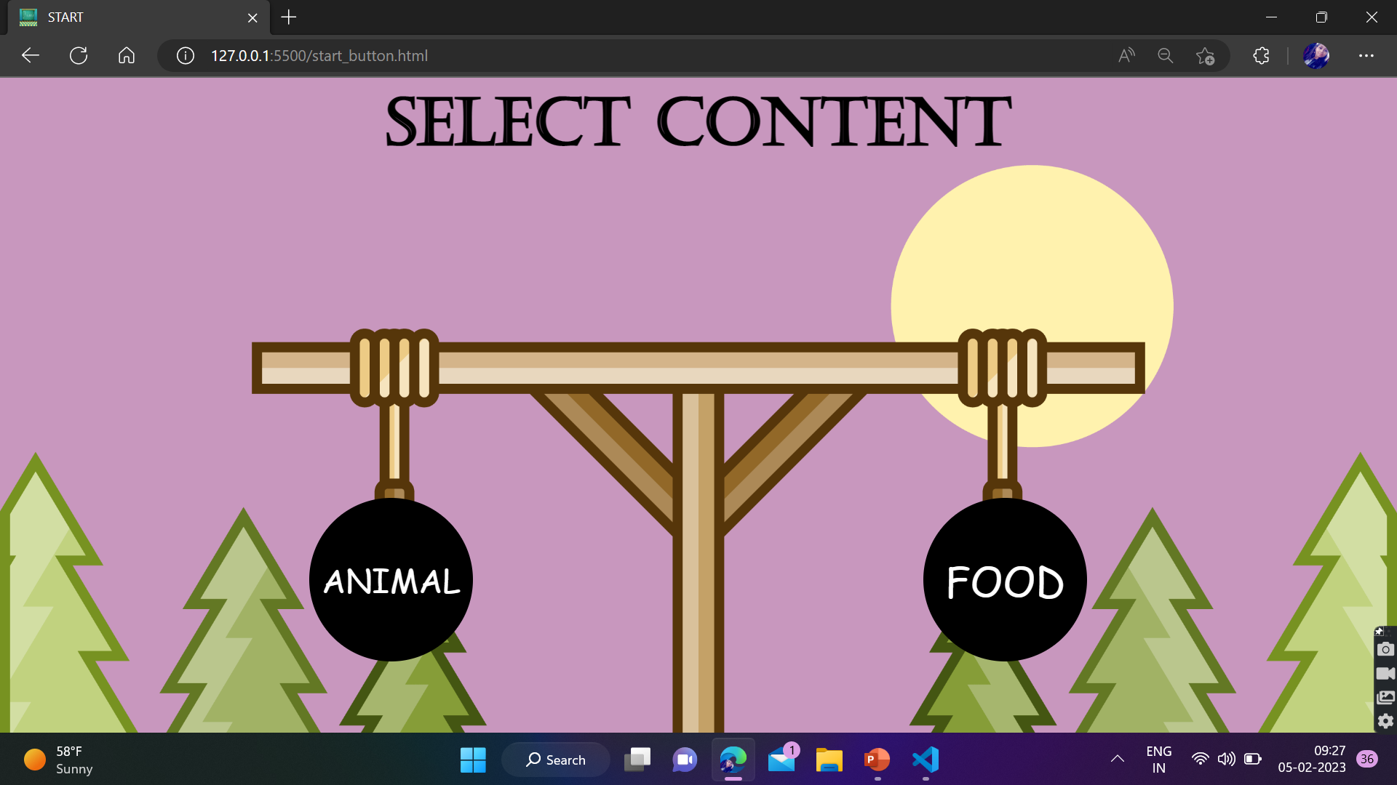
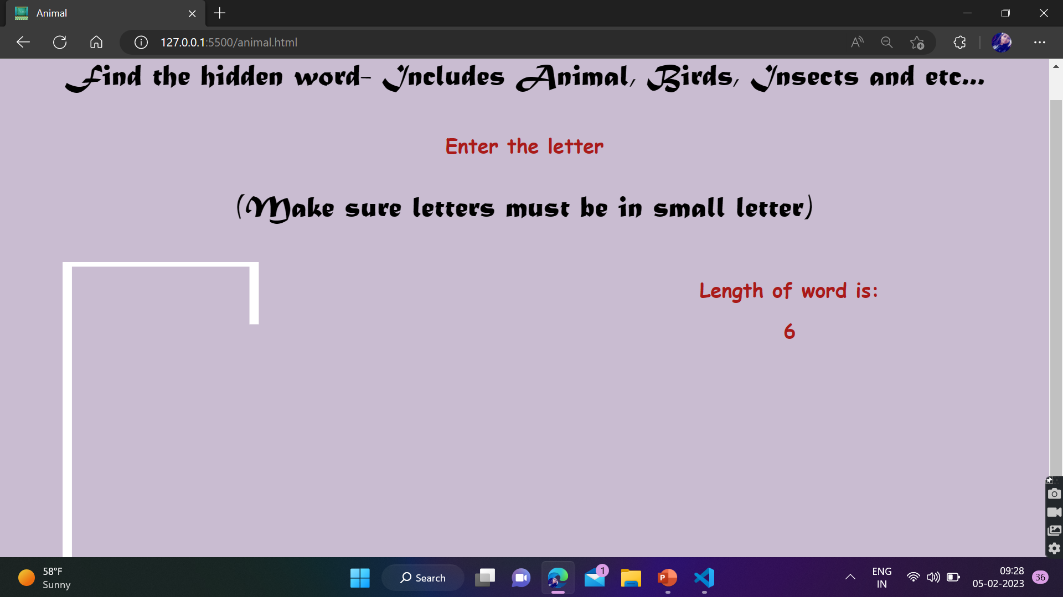
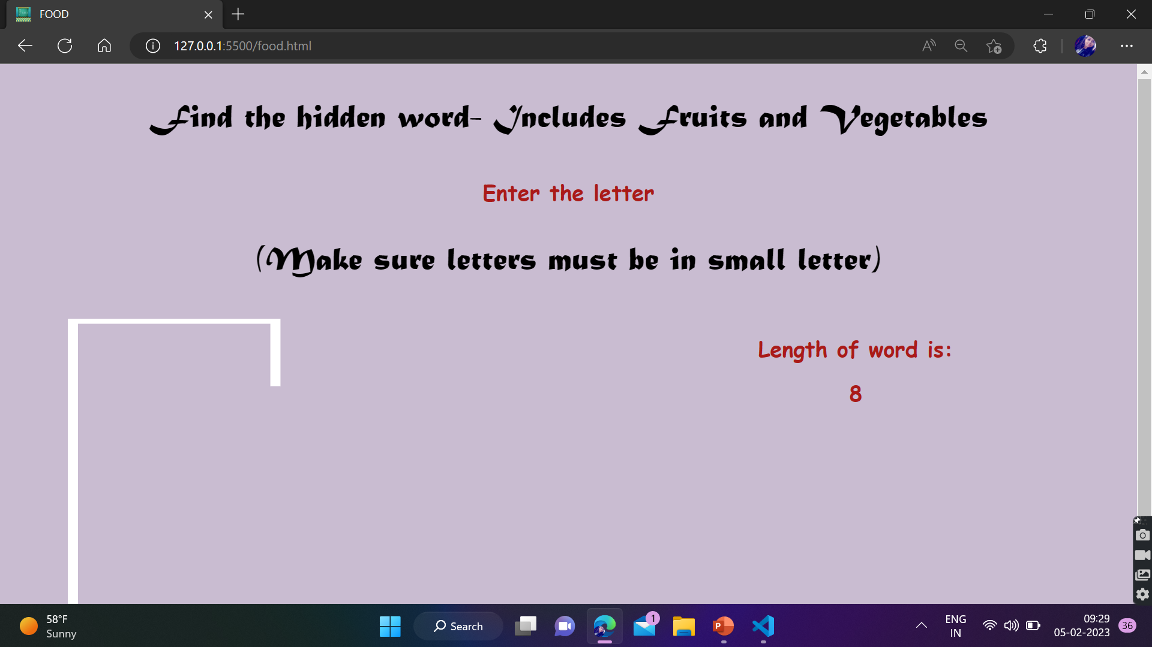

Slide 10

RESULT & OUTCOMES
FOR ME
Helps in understanding languages
Give me idea, how projects are created
FOR USER
Helps in their vocabulary
Helps them to enhance their memory and spellings.

Slide 11
REFERENCE
W3Schools Online Web Tutorials
Introduction to HTML, CSS, JavaScript & How websites work? | Web Development Tutorials #1 – YouTube
https://www.youtube.com/watch?v=CT0zccxghFo

Slide 12
THANK YOU

